Slide 1
Machine Learning
AND ITS TYPES

Slide 2
Machine Learning
Machine learning is an application of artificial intelligence (AI) that provides systems the ability to automatically learn and improve from experience without being explicitly programmed.
Machine learning algorithms build a mathematical model based on sample data, known as "training data", in order to make predictions or decisions without being explicitly programmed to perform the task.
It is seen as a subset of artificial intelligence.

Slide 3
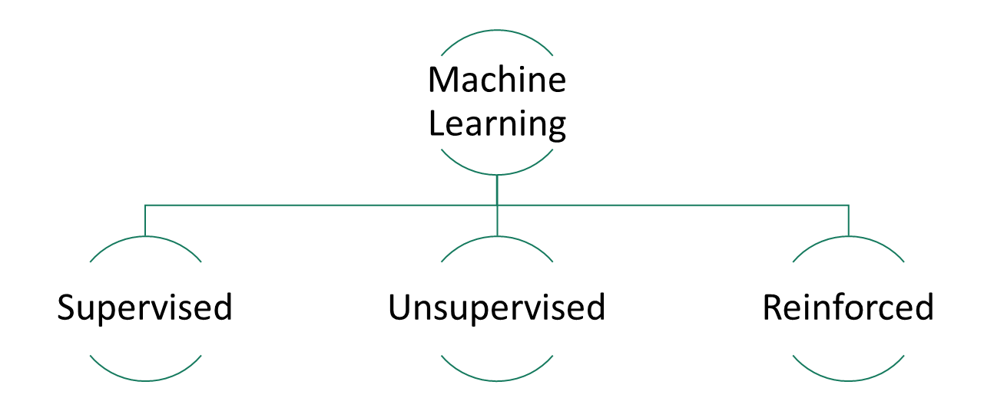
Types of ML algorithms

Slide 4
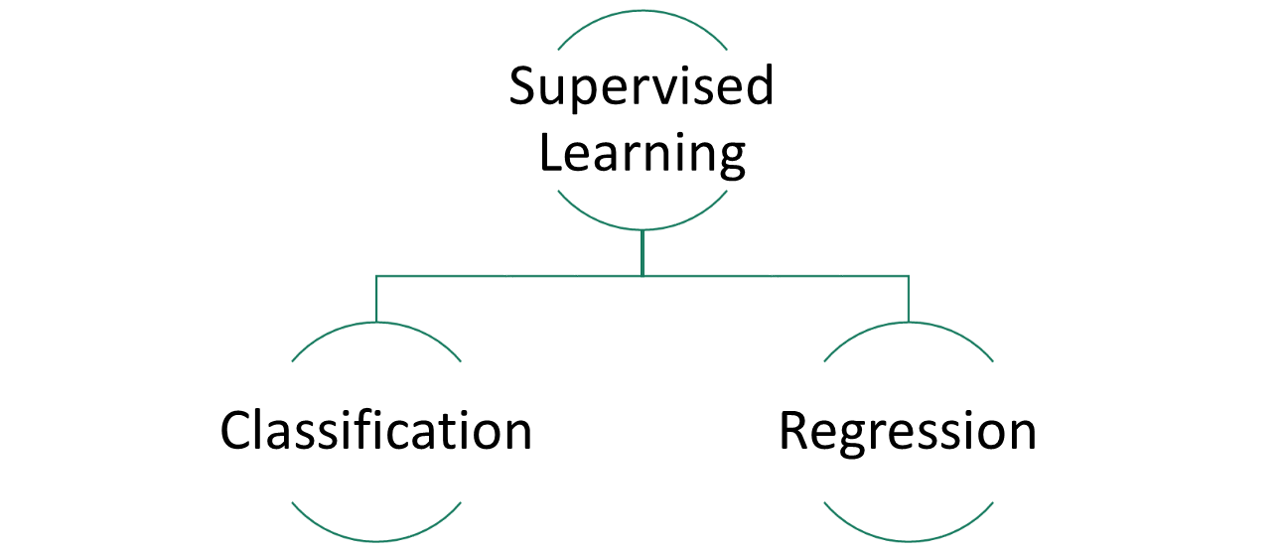
Supervised

Slide 5
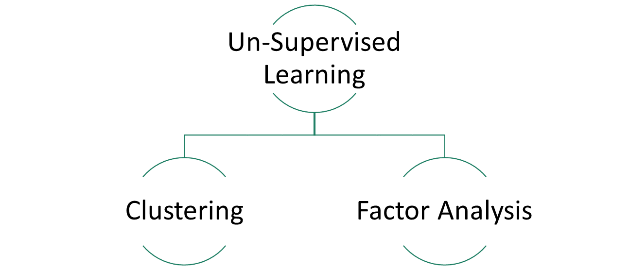
Un-Supervised

